Slide 1
Gossip: from the heart to my speech

Slide 2
GOSSIP DEFINED
Biblical synonyms include: Whispering, Backbitting, and Slander
Lies, unconfirmed facts, spreading of secrets and speech that concerns subjects that are none of our business
Its immediate consequences include fighting and a lack of love for my neighbor

Slide 3
WHAT FUELS GOSSIP
I want to satisfy my flesh
I want to harm another
A lack of purpose for my time

Slide 4
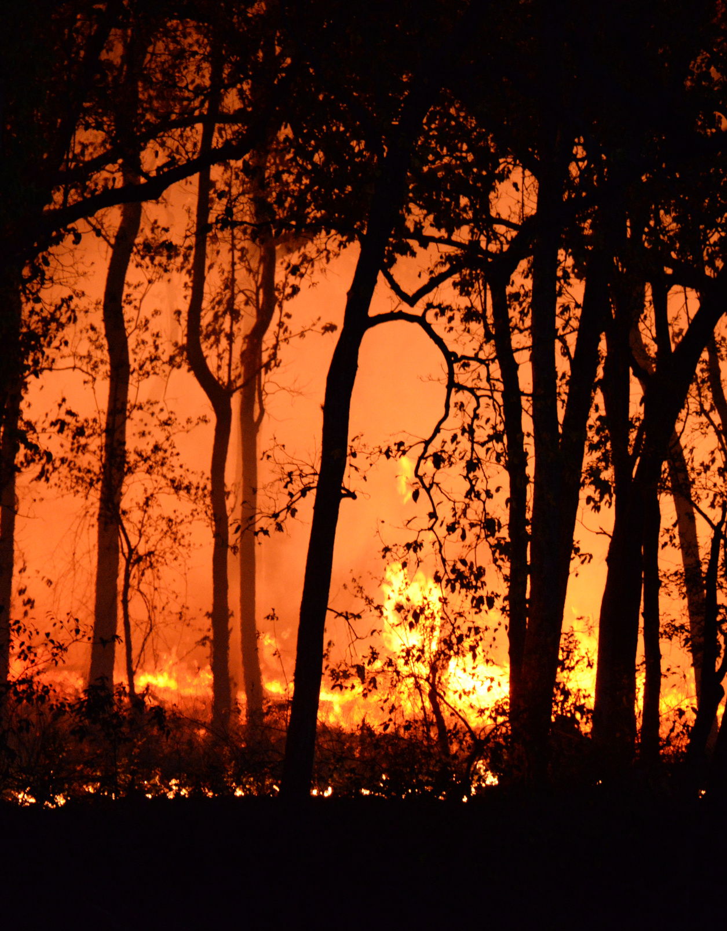
PUTTING OUT THE FIRE
Has the individual who is the subject of the matter been spoken to?
Avoid fake news
Recognize how serious it is to speak idle words

Slide 5
What Is A Healthy Amount Of Information?
It is not gossip to warn against public facilitators of sin
It is not gossip to seek aid for a problem when you go to the right source
When spreading information, seek the welfare of the subject matter

Slide 6
Have You Been Buned?
Bring it to God
Consider what was said but know that God is the judge
Act however you can with all gentleness

